Slide 1


Speech emotion recognition
Gourav verma
DSC-680 T302, spring-21
Applied Data science
Prof. fadi alsaleem
Bellevue univerSity

Slide 2

Table of contents
Data
Audio Signal
Audio Features
Data Preparation
Methodology
Results

Slide 3
data
Ryerson Audio-Visual Database of Emotional Speech and Song (RAVDESS)
1440 Audio Files
24 North American professional actors (12M/ 12F)
8 Emotions: Neutral, Calm, Happy, Sad, Angry, Fearful, Surprise, & Disgusted
Filename example: 03-01-06-01-02-01-12.wav
Audio-only (03)
Speech (01)
Fearful (06)
Normal intensity (01)
Statement "dogs" (02)
1st Repetition (01)
12th Actor (12)
Female, as the actor ID number is even.

Slide 4
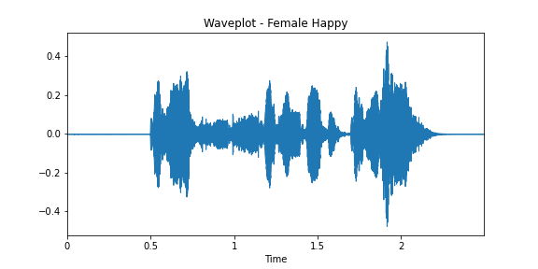
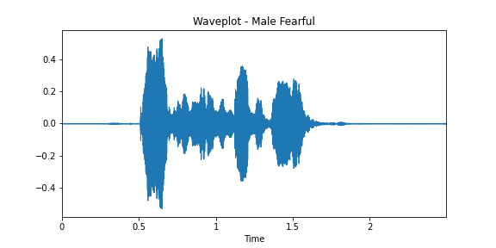
Audio signal
Female Happy with strong emotion
Male Fearful with strong emotion

Slide 5
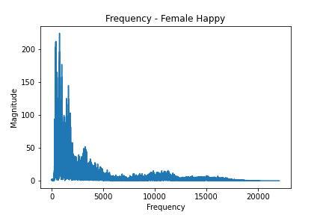
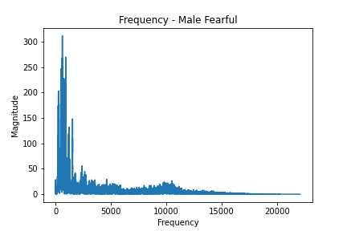
Audio signal
Female Happy with strong emotion
Male Fearful with strong emotion

Slide 6
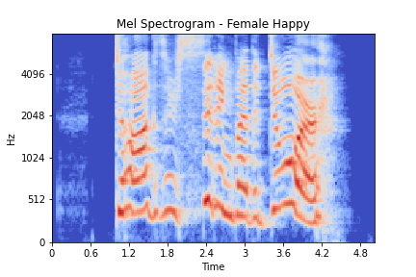
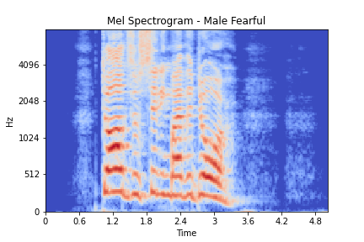
Audio signal features: Mel spectrogram
Female Happy with strong emotion
Male Fearful with strong emotion

Slide 7
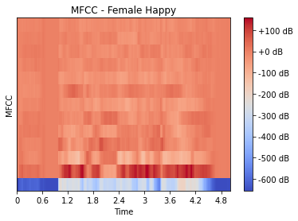
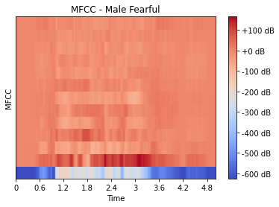
Audio signal features: Mel-Frequency Cepstral Coefficients
Female Happy with strong emotion
Male Fearful with strong emotion

Slide 8
Data preparation
Loaded all audio files into dataframe
Created/Merged Gender and Emotion column
16 gender-emotion labels (2 x 8)
Extracted 40 MFCCs
Added to dataframe as separate columns.

Slide 9
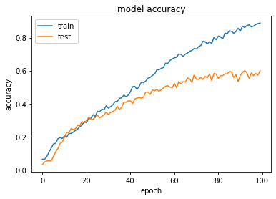
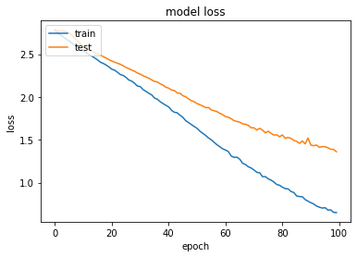
Methodology
Librosa package for EDA and Feature Extraction
Train-Test Split: 75%-25%
8-Layer 1D CNN
Trained on 100 epochs, batch size 16
Adam Optimizer
Accuracy 60%
Future
Other Engineered Audio Features
2D CNN, HMM

Slide 10
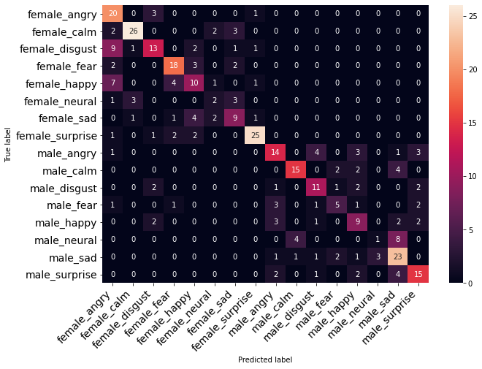
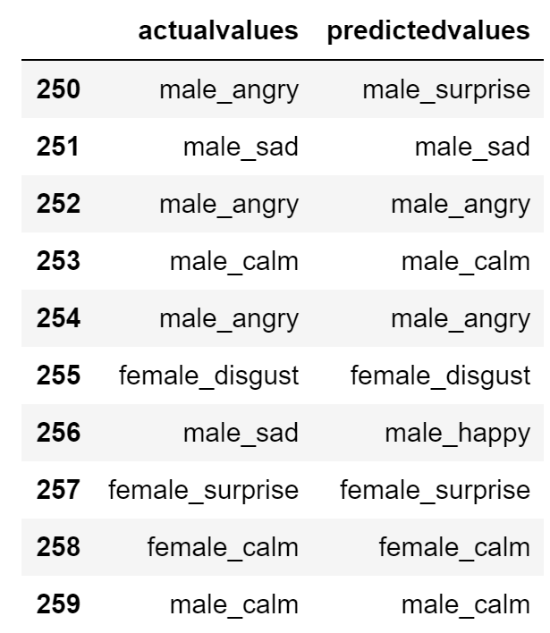
Outcome & prediction

Slide 11

Thank you

